Slide 1
Targeted Illumination iPython Notebook

Slide 2
Getting Started…
Path: C:/Users/speedf/3DFAST-main/Calibrate_DMD_notebook.ipynb
Environment: Anaconda base for C:/Users/Researcher
Camera: uManager w/ ‘Ham_Only’ configuration
Use uniform thin fluorescent slide and double check in-focus before starting
Close DLP GUI if it is open!!!!!!!!!

Slide 3
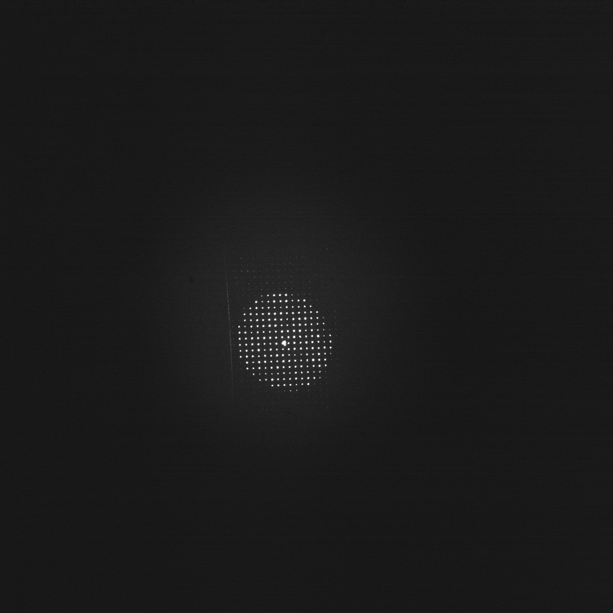
Step 1: Upload calibration mask
Run cell 2 to upload mask after imports (cell 1).
Increase camera exposure until dots are visible (only a few single pixels of the DMD are turned on)
Use fine axial adjust (if needed)
Should be able to resolve 4 tightly spaced dots in center
Snap image and save (.tif) to ‘C:/Users/speedf/3DFAST-main/data’

Slide 4
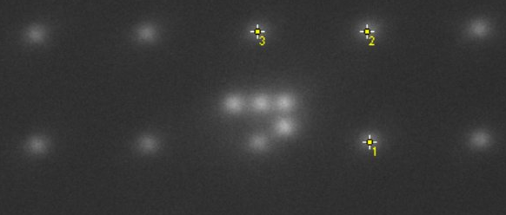
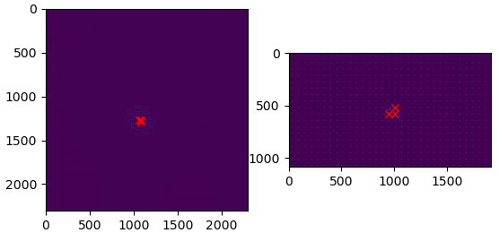
Step 2: Perform affine calibration (cell 3)
Update ‘img_fname’ variable to the .tif from step 1
Open the file in FIJI and locate three reference pixels
Update ‘centers_init’ variable
Centers_init = [[Y1,X1], [Y2,X2], [Y3,X3]]
Run cell to perform transform
-If it doesn’t work, check pixel size and magnifications in “options” variable as well as ‘ROI’ (the area around each DMD pixel that does not contain any other pixels on)

Slide 5
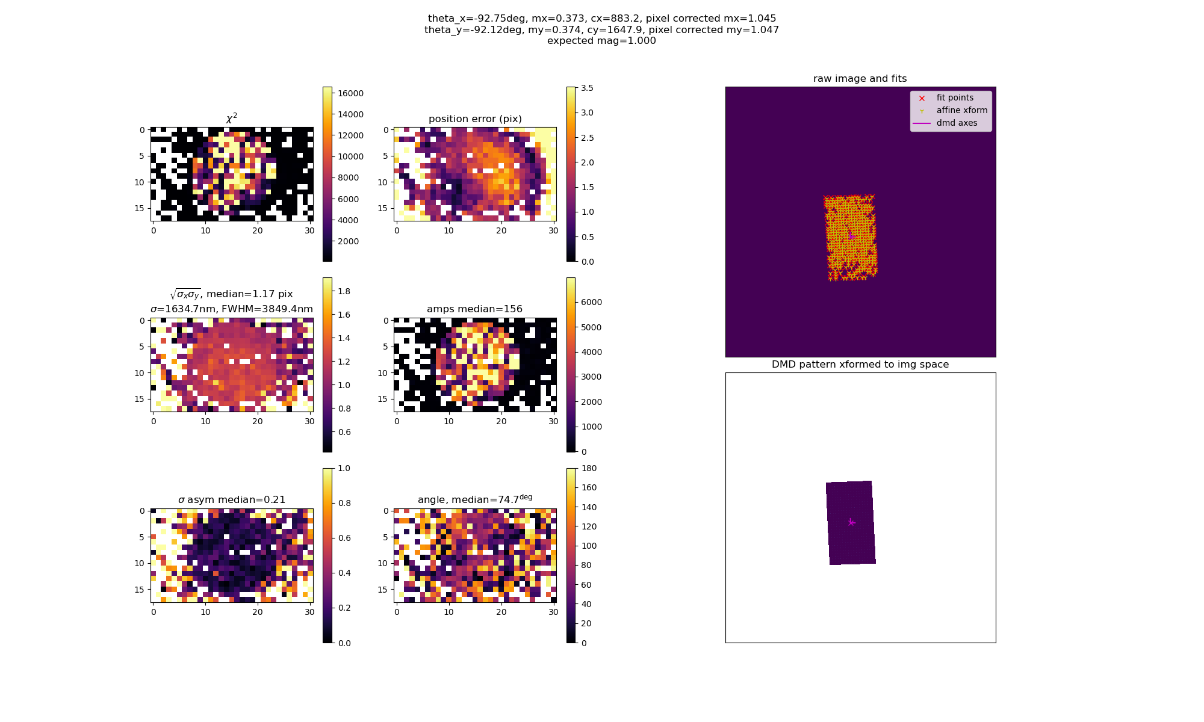
Step 2: Perform affine calibration (cell 3)
Steps 1-2 are not necessarily required if there haven’t been changes to optical path
- good to do this every week or so, regardless

Slide 6
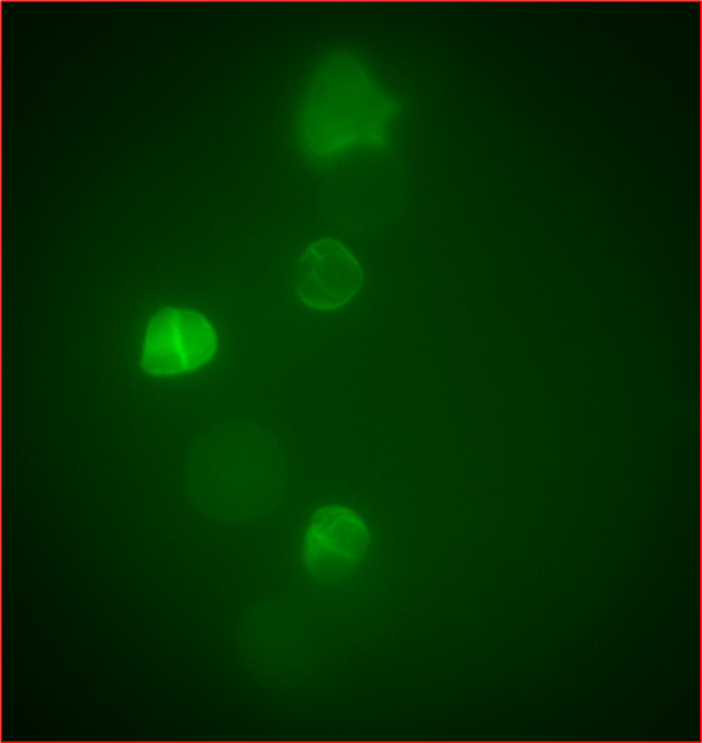
Step 3: Convert Camera Targets to DMD Mask
Restart kernal (if calibration was needed)
Upload FBr.bmp to DMD (Python or DLP GUI)
Find cells of interest and snap image (long exposure), save to same ‘data’ folder as before
Use FIJI to convert from .tif to .jpg (needed for next step)
Close DLP GUI!!!!

Slide 7
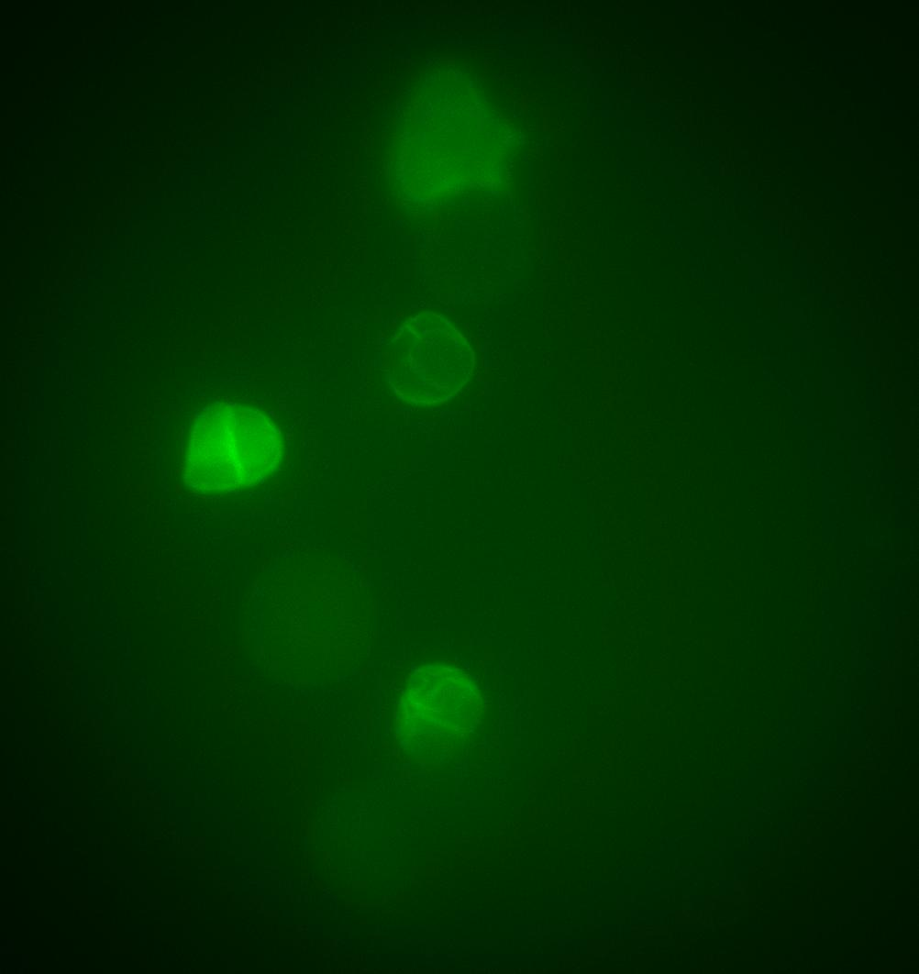
Step 3: Convert Camera Targets to DMD Mask
Need to update variables in cell 4:
‘img_fname’ = calibration image from step 1
‘save_dir’ = path to folder saved during calibration (it will be in data folder in this format: data_time_affine_calibration)
‘img2’ = string for jpeg saved earlier
2 instances of ‘img2’ in “draw_reactangle_with_drag” function
‘test_path’ should also be set to the jpeg saved earlier
‘num_targets’ should be equal to the number of cells for TI
Run cell 4 and use mouse to draw rectangles around each target in the window that pops up

Slide 8
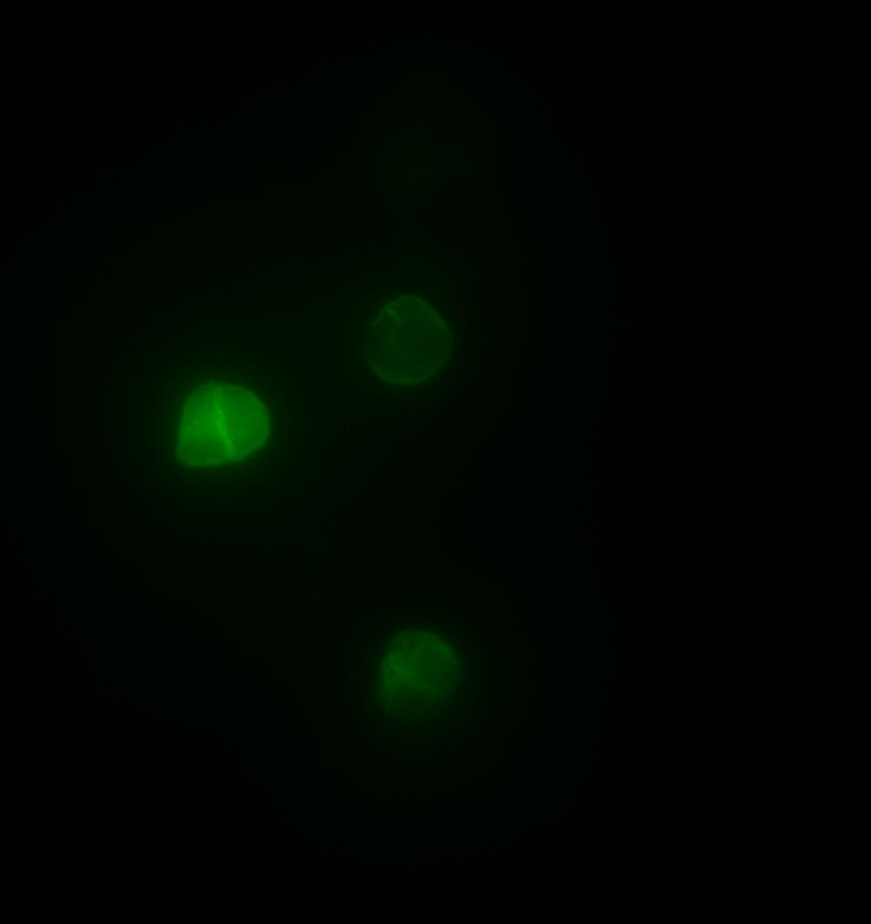
Step 4: Record!
Leave kernal running and use uManager to record.
Redo step 3 for each new FOV or after significant motion.
No harm in repeating steps 1-2 for each recording (but not crucial if there have been no system changes).

